Slide 1


ANALYZING CRIME
IN THE CITY OF CHICAGO
Team 4: Danielle Santamaria, Liliana Sifuentes, Ngoc Nguyen
CIS 5200
Date

Slide 2

DATASET
SPECIFICATIONS
Data Size: 2.02 GB
Data Source URL : City of Chicago Crime Data | City of Chicago | Data Portal
Data Format: CSV Number of Records: ~8+ million rows
Hadoop Version: 3.4.1
Hive Version: 3.1.3
Cluster Configuration: 5 Nodes Total, 2 Master Nodes & 3 Worker Nodes
Hardware Specifications: CPU: AMD EPYC 7J13 ~2.45 GHz, 6 vCPUs per node. Memory: ~32 GB RAM per node
Github link: dsanta22-chicago-crime-hive-analysis

Slide 3
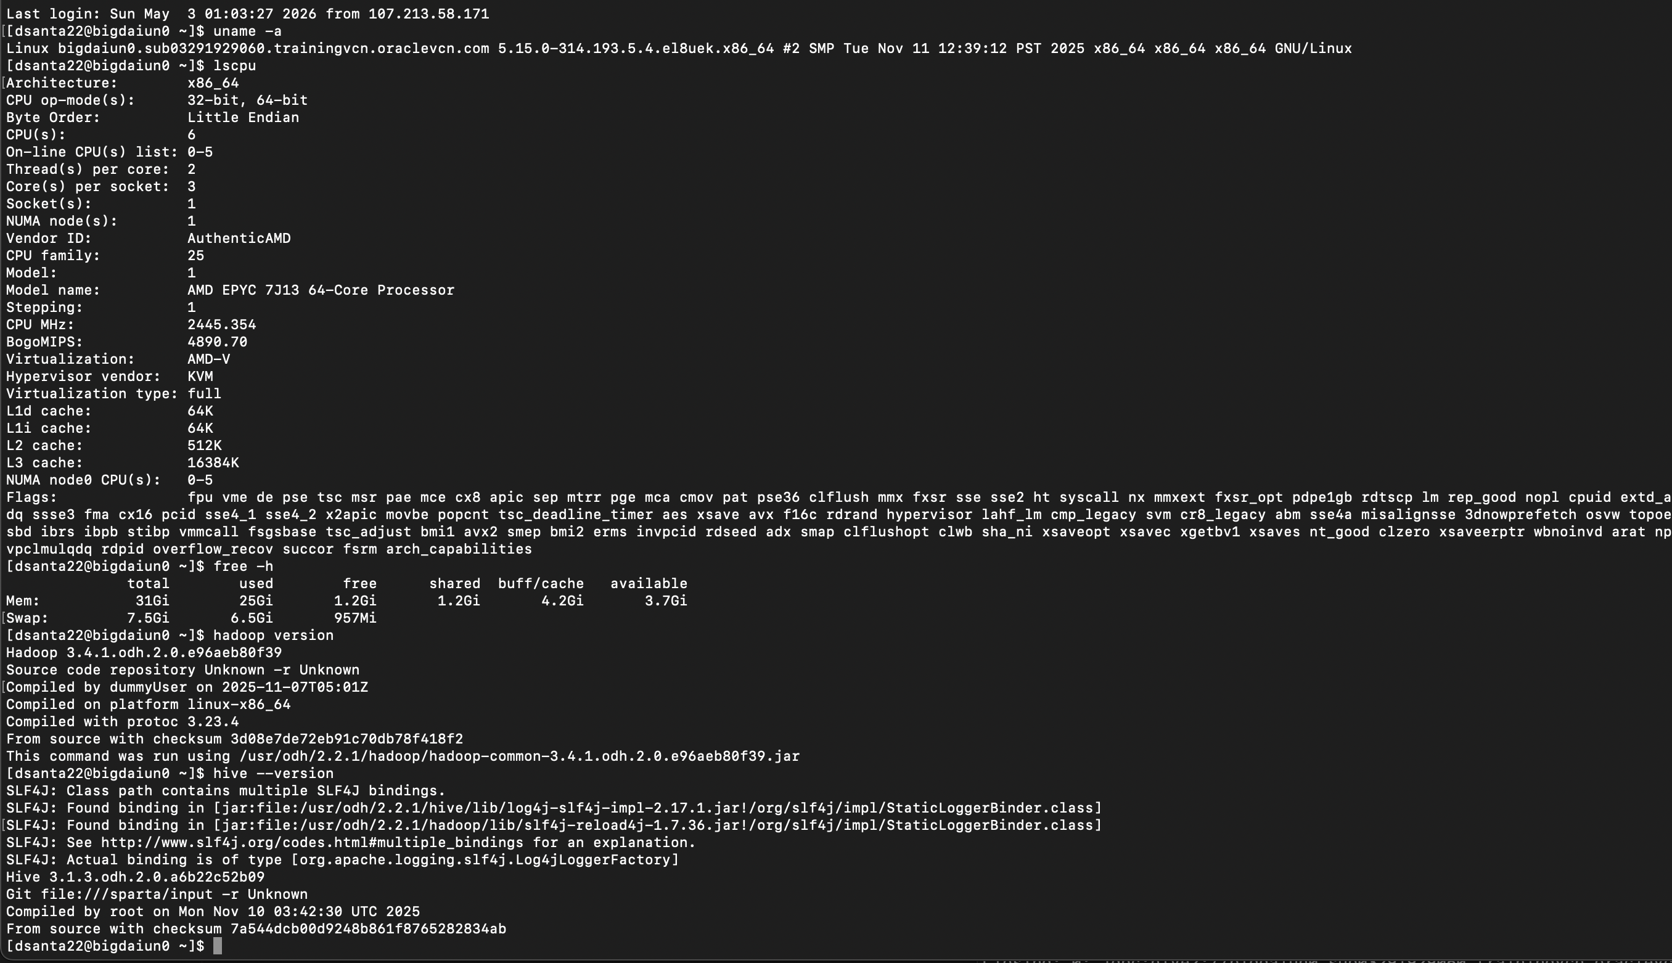
DATASET SPECIFICATIONS

Slide 4
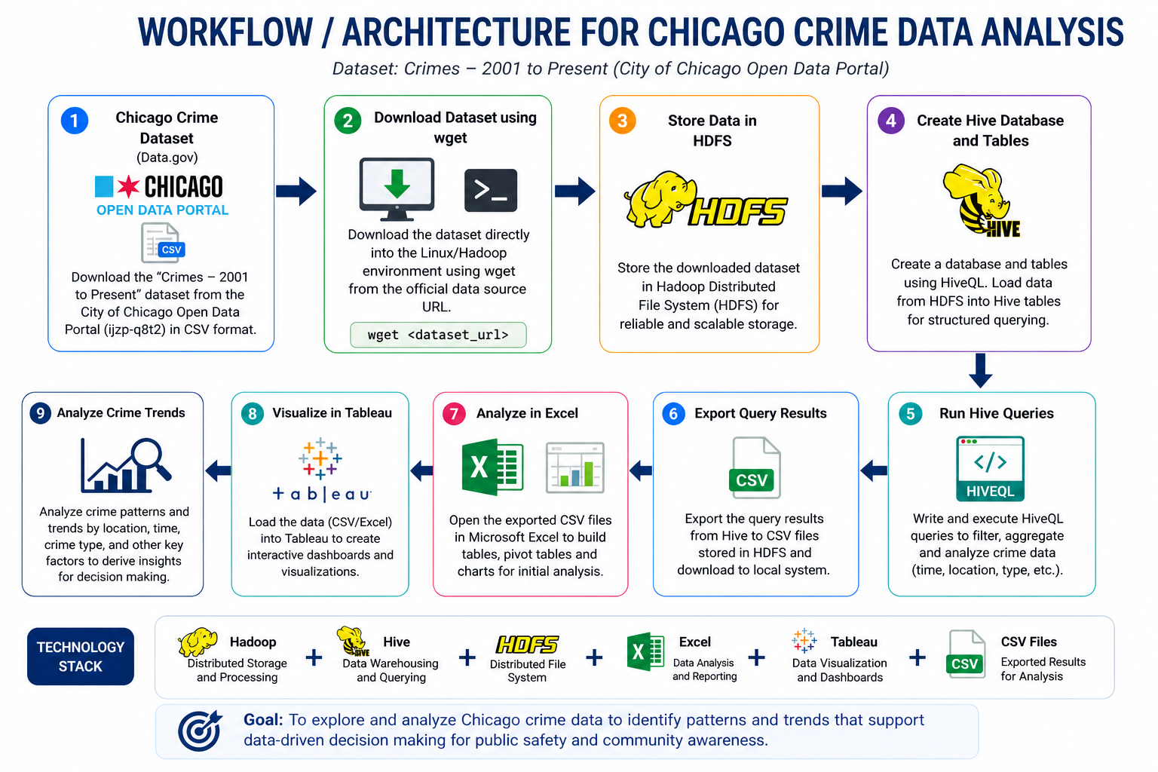

Slide 5
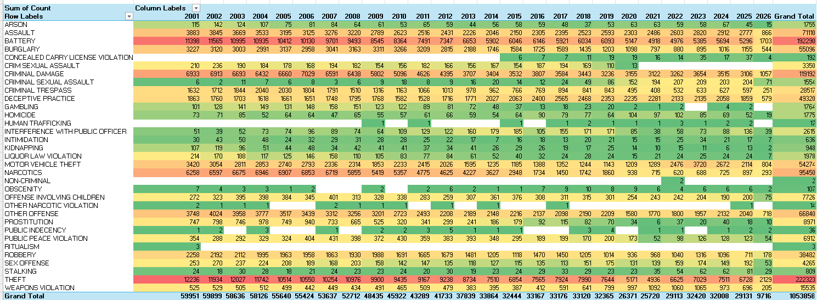
CRIME HOTSPOTS IN CHICAGO HEATMAP
​
Darker colors = higher crime frequency.
Theft, battery, and criminal damage appear most frequently
Crime levels vary across years and categories
Some crimes decrease over time while others remain consistent

Slide 6
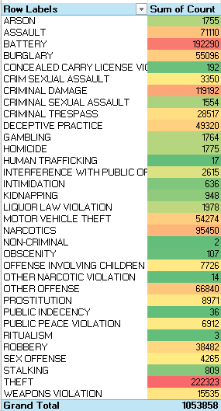
CRIME VOLUME
KEY STATISTICS
This summarized heat map highlights overall crime frequency by category, showing which crimes occur most frequently overall.
Theft is the most common crime across all years and shows consistently high counts compared to other crimes
Battery and criminal damage are also highly frequent
Some crime categories show a decrease in later years
The data helps identify which crimes require more attention
Total reported crimes
Most frequent crime category
1053858
Theft

Slide 7
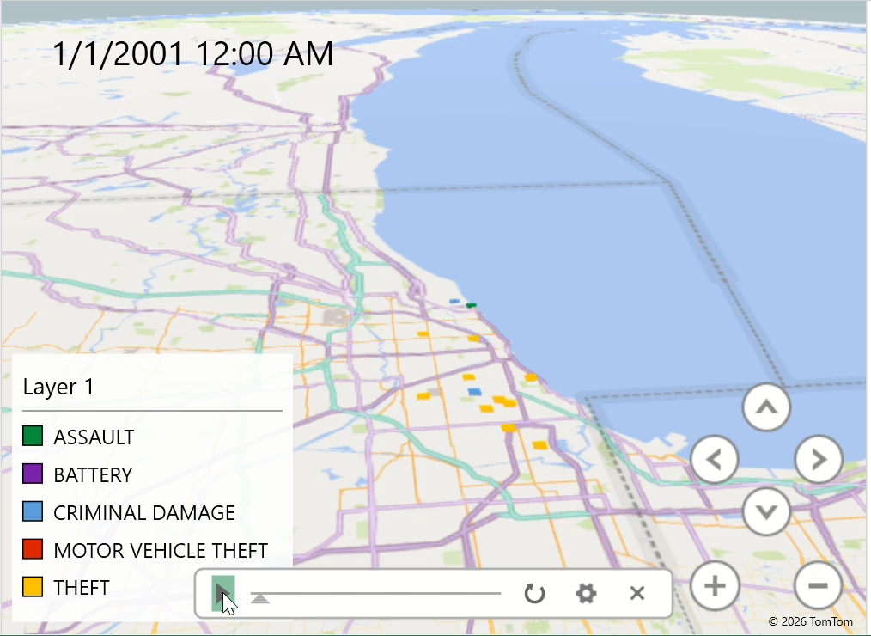
3D Map Excel
Combines spatial (location) and temporal (time) data to show how crime patterns change across Chicago over time
Displays crime locations across Chicago using a 3D map
Taller bars represent areas with higher crime counts
Shows where crime is concentrated = hotspots
Different colors represent different crime types
Helps visualize patterns by location and over time

Slide 8
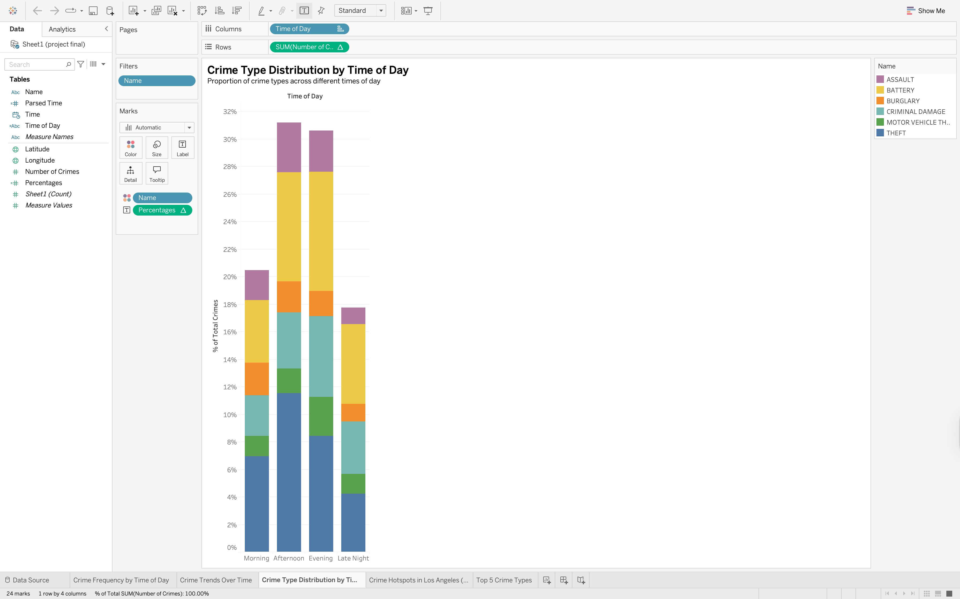
CRIME TYPES
• Theft is the most common crime across all times of day
• Battery is the second most frequent crime
• Criminal damage is also consistently high
• Crime types vary depending on the time of day
• Certain crimes increase during afternoon and evening hours

Slide 9
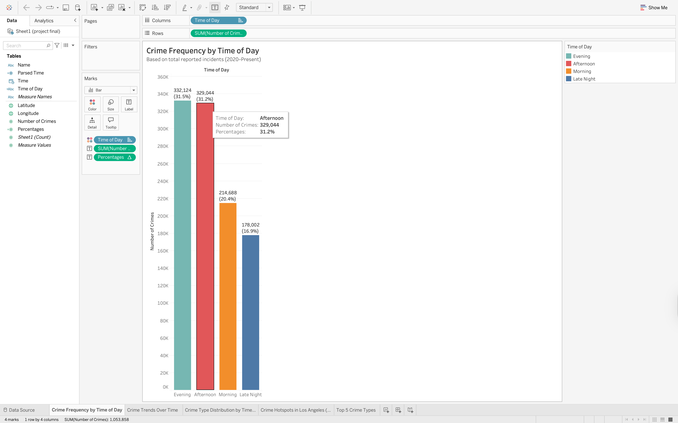
CRIME FREQUENCY BY TIME OF DAY
• Crime frequency varies across different times of the day
• Evening has the highest crime rate ~31.5%
• Afternoon is also high and very close to evening ~31.2%
• Morning shows moderate crime levels ~20%
• Late night has the lowest crime activity ~17%
• Crime is more concentrated during active daytime/evening hours

Slide 10
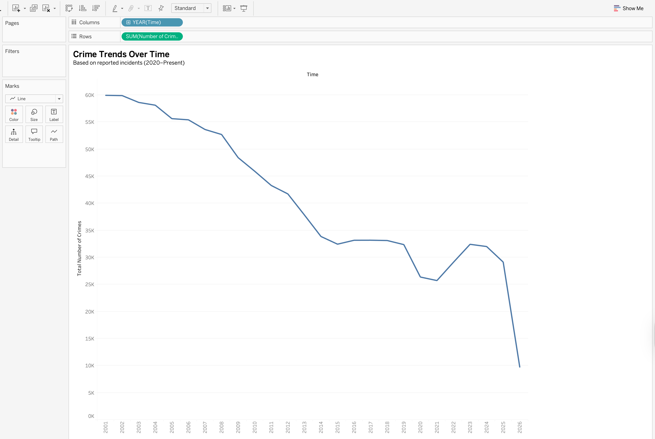
CRIME TRENDS OVER TIME
• Crime levels show a general downward trend over time
• There is a noticeable decline after the early 2000s
• Crime rates become more stable in recent years
• The sharp drop in the final year is likely due to 2026 not being over yet.

Slide 11
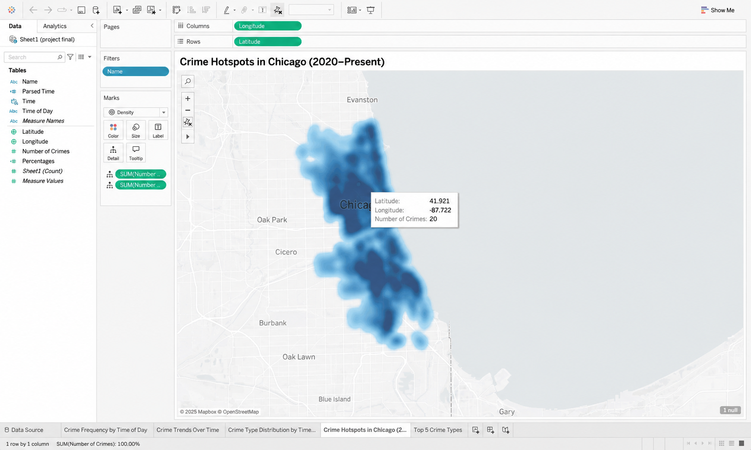
CRIME HOTSPOTS BY LOCATION
• Darker areas represent higher crime concentration
• Crime is clustered in specific geographic locations (hotspots)
• Certain areas consistently show higher crime activity
• These hotspots indicate where crime is more frequent over time
• Helps identify locations that may need more attention or resources

Slide 12
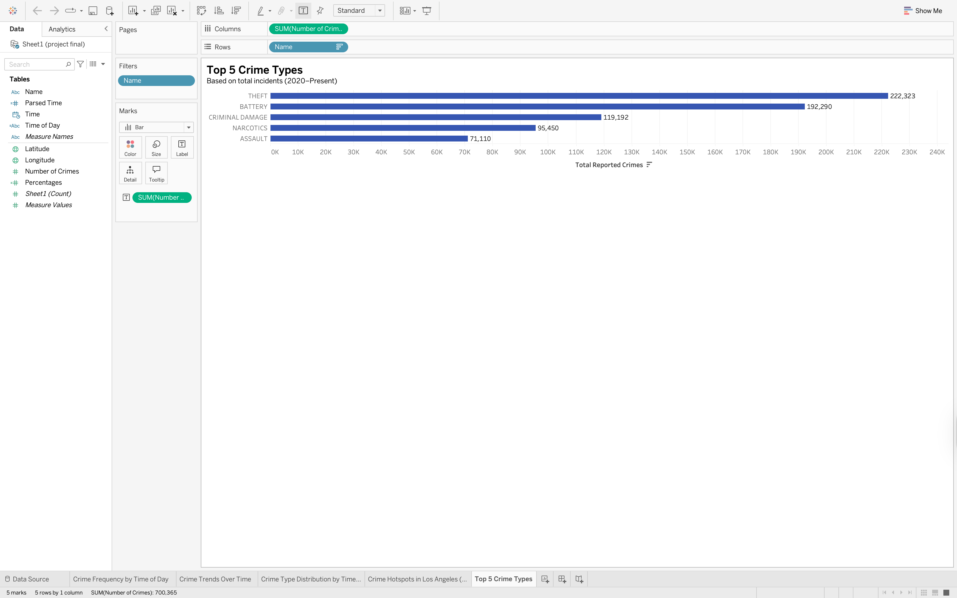
Top 5 Crime Types
Theft is the most common crime by a large margin
Battery is the second most frequent crime
Criminal damage ranks third among reported crimes
Narcotics and assault also appear frequently
These top categories make up a large portion of total crimes

Slide 13


THANK YOU
Questions?
Contact
Resources

